Slide 1
Sociology: 3549 Hypothesis testing
Recitation #9
Yue Chu

Slide 2
announcement
Homework #2 is being graded.
Solutions and grading rubric will be uploaded to Carmen after grading is complete.
Two bonus points for lab attendance.

Slide 3
agenda
Review of lecture
Activity
Hypothesis testing
One sample Z test
In class exercise
Upload your answer to Carmen for attendance
Stata

Slide 4
Inferential statistics
How your sample would behave if you know the “true” distribution of your population?
What do we know about the true population mean based on single random sample?

Slide 5


Hypothesis testing
Single mean test
Test population mean in relation to a hypothesized value
Two means test
Test whether population means from two populations differ
Notes:
Walrus

Slide 6
H₀ vs H₁
H₀ (Null hypothesis)
No statistically significant difference between the test population and hypothesized mean.
Two mean test: no statistically significant difference between the two population means.
In other words, the difference you observe in sample means is caused by random chance.
H₁ (or H_{a}, Alternative hypothesis)
Single mean test: statistically significant difference between the test population and hypothesized mean.
Two mean test: one population mean is statistically significant different from the other population mean.

Slide 7


reject H₀ vs fail to reject
Based on the null hypothesis, whether observing the sample would be a rare event.

Slide 8



fail to reject ≠ accept
H₀: all apples are red.

Slide 9
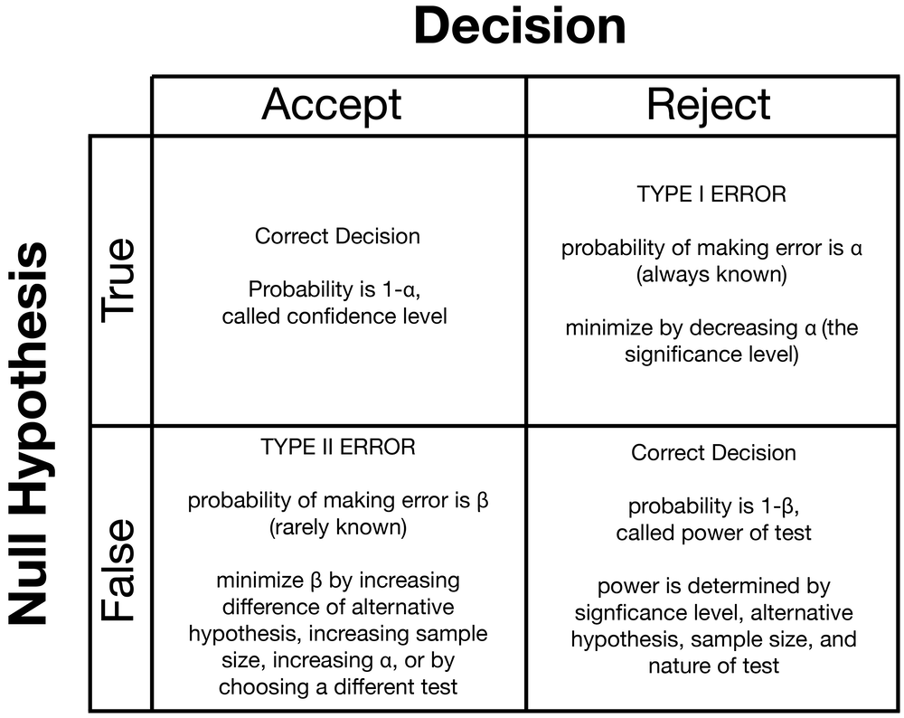
Type of errors

Slide 10
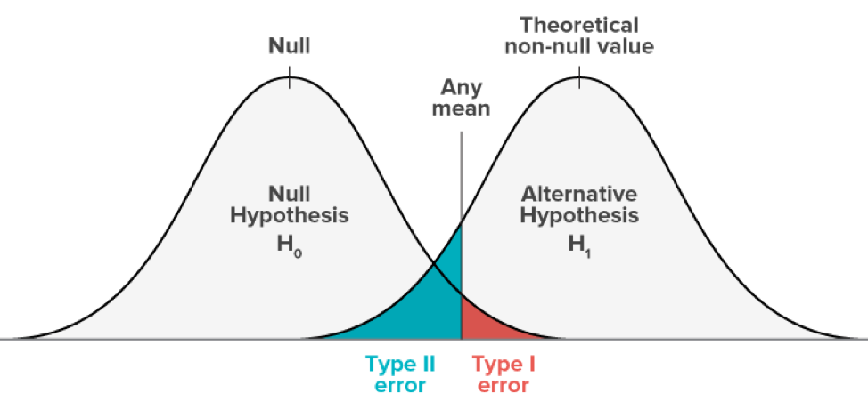



Select appropriate significance level
Decide what type of error to minimize
Usually decrease type I error
Small $α$
Usually at 0.05
$$β$$
Accept false H₀
$$α$$
Reject true H₀
Significant level is, given H₀, proportion of area under the sampling distribution that contains the “rare” sample outcomes.

Slide 11
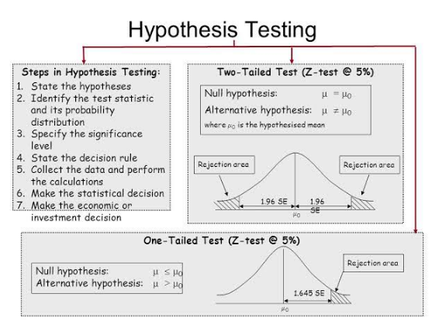
Steps for test hypothesis
State
State hypothesis (H₀ vs H₁)
Sig.
Set significance level ($α$) and decide critical region
Set significance level (𝜶) and decide critical region
Calculate
Collect sample and compute test statistics
Decide
whether reject / fail to reject H₀

Slide 12
Steps for test hypothesis
State
State hypothesis (H₀ vs H₁)
Sig.
Set significance level ($α$), decide critical region
Set significance level (𝜶), decide critical region
Calculate
Collect sample and compute test statistics
Decide
whether reject / fail to reject H₀

Slide 13
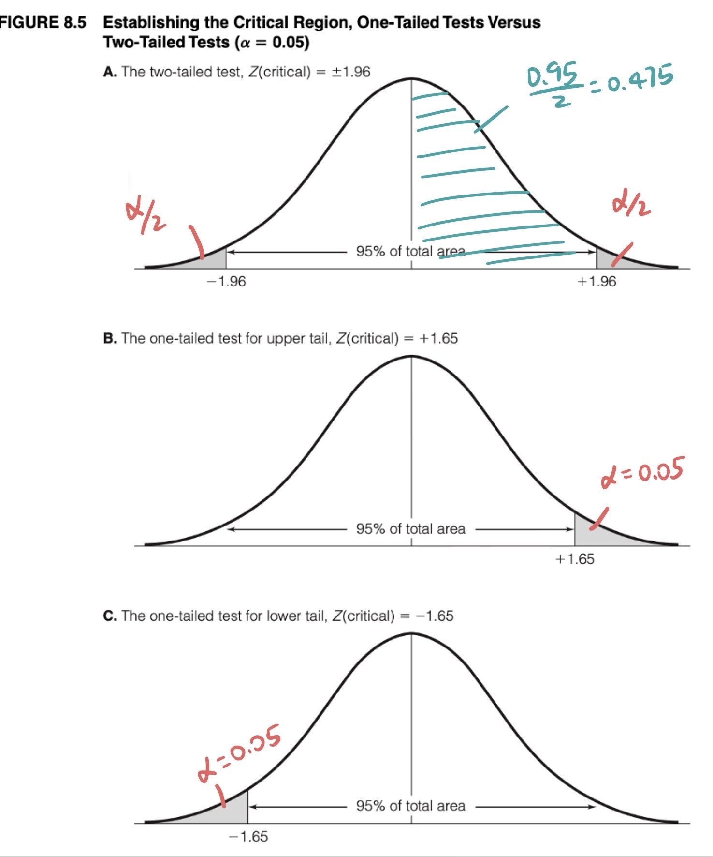
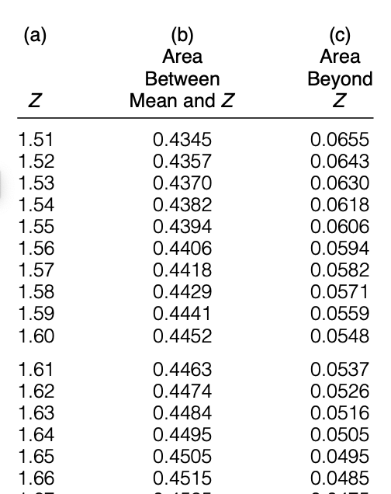
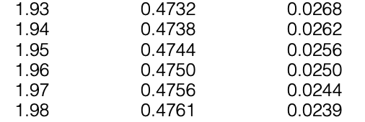
Single mean / one sample z-test
State
State hypothesis (H₀ vs H₁)
Sig.
Set significance level ($α$) and decide critical region
Set significance level (𝜶) and decide critical region

Slide 14
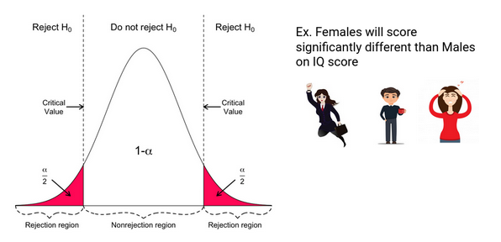
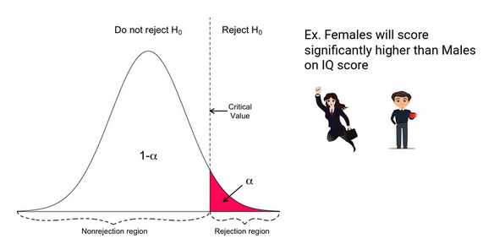
Single mean / one sample z-test
State
State hypothesis (H₀ vs H₁)
Sig.
Set significance level ($α$) and decide critical region
Set significance level (𝜶) and decide critical region

Slide 15
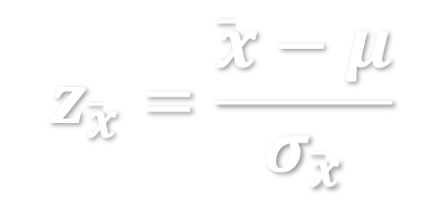
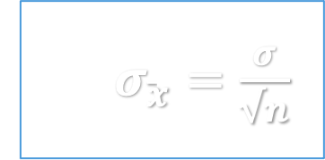
Single mean / one sample z-test
Calculate
Collect sample, and compute test statistics
$$z_{\overline{x}}=\frac{\overline{x}−μ}{σ_{\overline{x}}}$$
SE:$σ_{\overline{x}}=\frac{σ}{√n}$

Slide 16
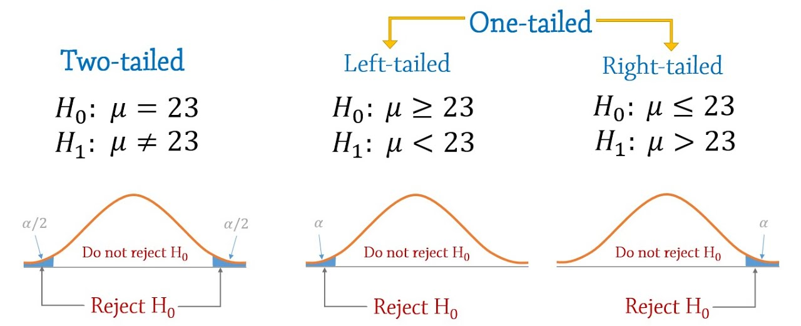
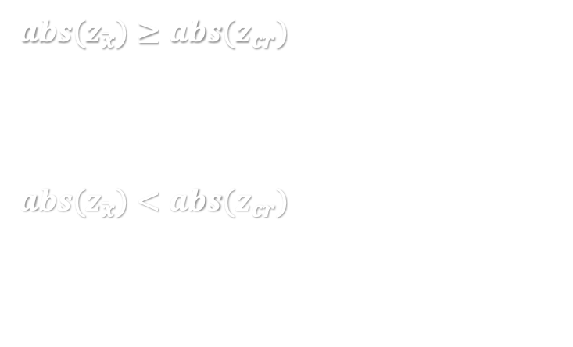



Single mean / one sample z-test
Decide
whether reject / fail to reject H₀
${abs(z}_{\overline{x}})≥abs(z_{cr})$ - Reject H₀ at sig. level of $α$ / at confidence level of (1-$α$), based on the sample.
${abs(z}_{\overline{x}})<{abs(z}_{cr})$ - Fail to reject H₀ at sig. level of $α$/ at confidence level of (1-$α$), based on the sample.
$$z_{α/2}=±1.96$$
$$z_{α}=−1.65$$
$$z_{α}=+1.65$$
Notes:
Z_cr is z of critical region, Z(alpha/2) if two tailed test, Z(alpha) if one tailed test.

Slide 17

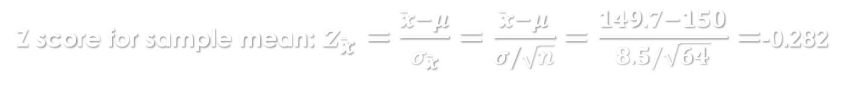
EXAMPLE – one-tailed single mean z-test
GRE verbal test score has SD = 8.5. To test the hypothesis that the average GRE score for all student is above 150 ($μ>150)$, we took a sample of n=64 students, and calculated their mean score $\overline{x}$=149.7.
H₀: Mean test score $μ≤150$ ; H₁: Mean test score $μ>150$
Statement
Sig. level
Calculate
Decide
Set the significant level $α=0.05$. For one-tailed test, $z_{α}=+1.65$
Z score for sample mean:$z_{\overline{x}}=\frac{\overline{x}−μ}{σ_{\overline{x}}}=\frac{\overline{x}−μ}{σ/\sqrt{n}}=\frac{149.7−150}{8.5/\sqrt{64}}=$-0.282
Based on our sample of 64 students, at 95% confidence level / at 0.05 significance level, we fail to reject the null hypothesis that average GRE score for all students falls is no more than 150.

Slide 18
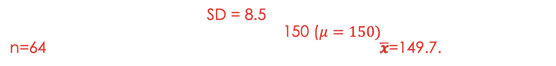
EXAMPLE – two-tailed single mean z-test
GRE verbal test score has SD = 8.5. To test the hypothesis that the average GRE score for all student is 150 ($μ=150)$, we took a sample of n=64 students, and calculated their mean score $\overline{x}$=149.7.
H₀: Mean test score $μ=150$ ; H₁: Mean test score $μ≠150$
Statement
Sig. level
Calculate
Decide
Set the significant level $α=0.05$. For two-tailed test, $z_{α/2}=±1.96$
Z score for sample mean:$z_{\overline{x}}=\frac{\overline{x}−μ}{σ_{\overline{x}}}=\frac{\overline{x}−μ}{σ/\sqrt{n}}=\frac{149.7−150}{8.5/\sqrt{64}}=$-0.282
Based on our sample of 64 students, at 95% confidence level / at 0.05 significance level, we fail to reject the null hypothesis that average GRE score for all students falls is 150.

Slide 19
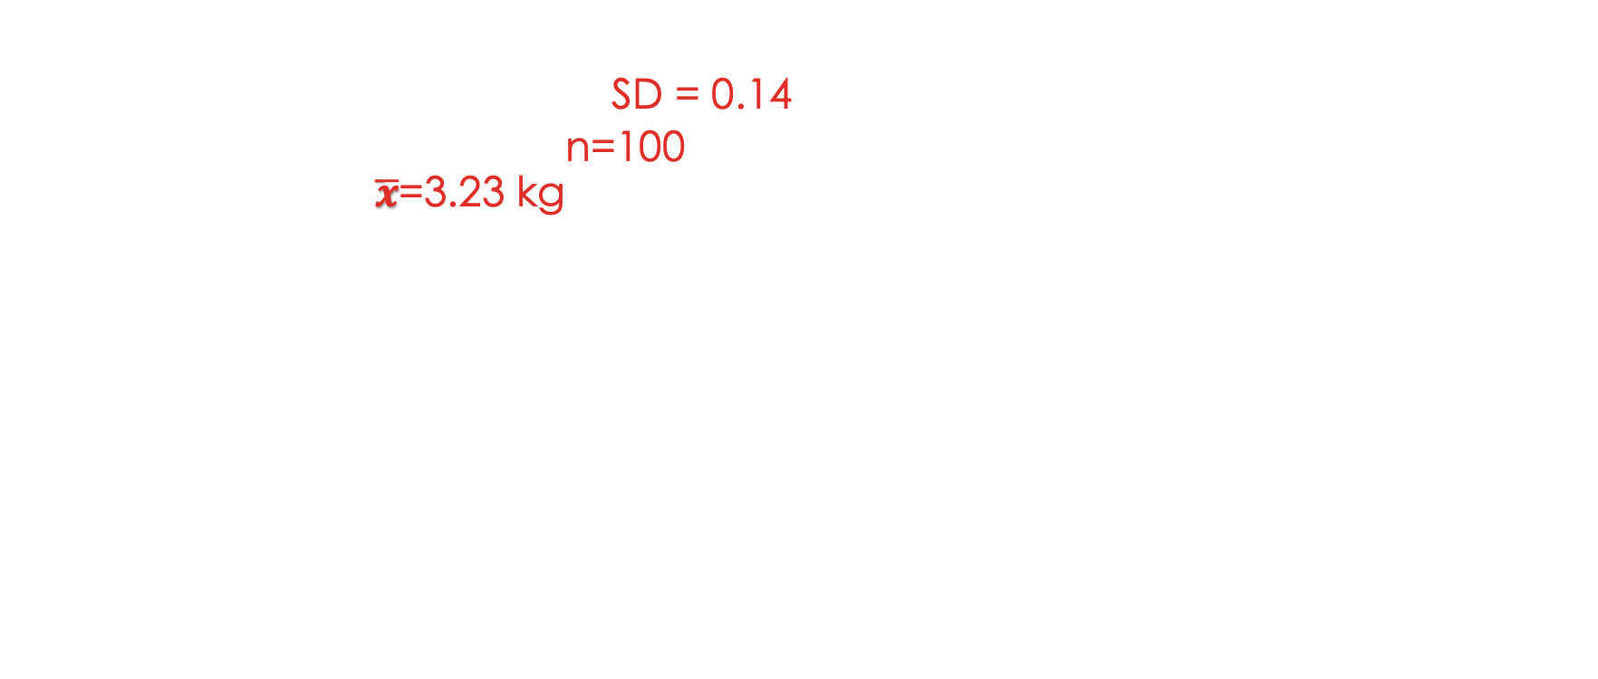
In-class exercise
Birth weight example
US girls has birth weight: SD = 0.14
You took a sample of n=100 newborn girls, and calculated their mean birth weight $\overline{x}$=3.23 kg
Question
Test hypothesis: US girls has mean birth weight no less than 3.5 kg.
Set significant level at $α$=0.10
Write your H₀ ,H₁ and specify whether it is a one-tailed or two-tailed z-test
Specify z score defining critical region
Write your decision: reject or fail to reject your null hypothesis
Type your answer in Carmen – Lab attendance

Slide 20
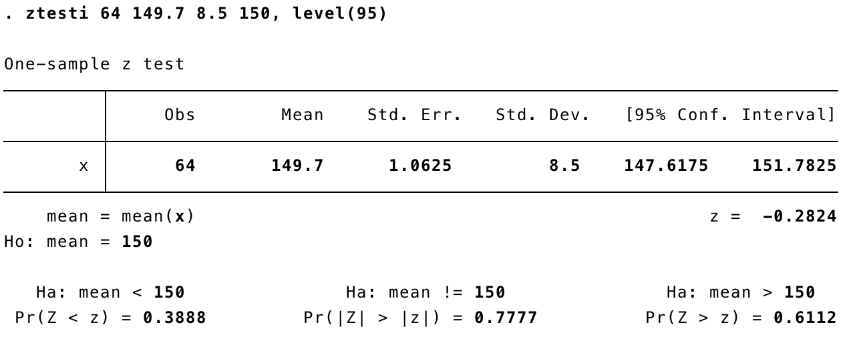

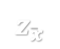
Stata: one sample z test from summary statistics
ztesti <sample size> <sample mean> <population SD> <hypothesized mean>, level(<confidence level>)
Confidence level is 1- $α$
$$z_{\overline{x}}$$
Two tailed z-test
One tailed z-test
One tailed z-test
Reject null hypothesis if this value is less than your pre-specified $α$ level.

Slide 21
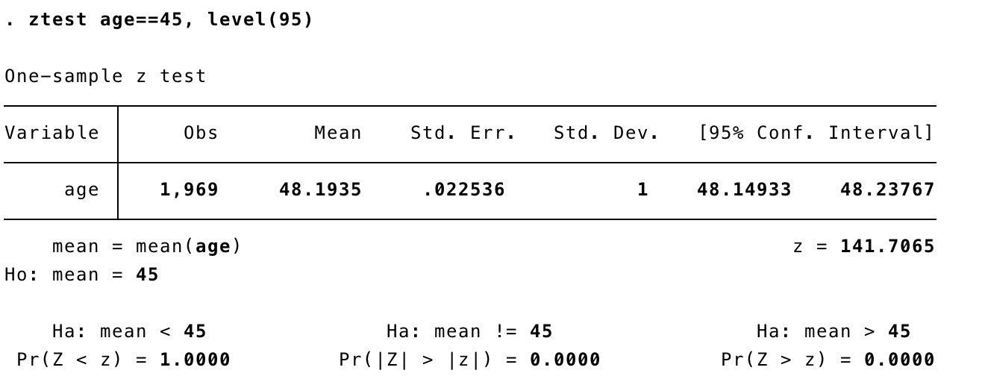

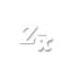
Stata: one sample z test from variable
ztest <variable> == <hypothesized mean>, level(<confidence level>)
Confidence level is 1- $α$
$$z_{\overline{x}}$$
Two tailed z-test
One tailed z-test
One tailed z-test
Reject null hypothesis if this value is less than your pre-specified $α$ level.

